Slide 1
class of 2025 Senior Meeting Spring 2025 Updates & reminders

Slide 2
Class officers
President – Zoe Li
Vice President – Dylan Rabinovitz
Secretary – Amelia Olowu
Treasurer – Eesha Dasani
Historian – Frida Najera
Social Media – Harini Ganesh

Slide 3
Class sponsors and contact info
Class of 2025 Administrator: Dr. Sarah Brown
Sarah.brown@fortbendisd.gov
Class of 2025 Sponsors: Mrs. Yvonne Leija-Leroux and Ms. Nneji
yvonne.leijaleroux@fortbendisd.gov
lotanna.nneji@fortbendisd.gov
For the quickest response, please email Mrs. Leija-Leroux or Ms. Nneji for questions or concerns about Senior Events/Activities.
Yearbook Advisor and Cady Contact: Mr. Reyes
elias.reyes@fortbendisd.gov

Slide 4
Social Media
@elkinsco25
@elkinsco25
*follow for updates, flyers, and fundraiser/promotion info!*

Slide 5
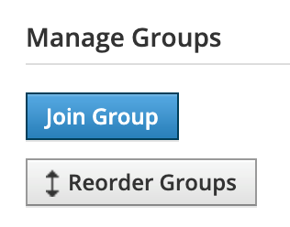
Schoology Group
*MUST be on this to get important info & details!*
Open Schoology and click "groups“
Click "my groups" on the left corner
Under Manage Groups, click "join group“
Enter this code: 8PCV-TQB4-SJFCH

Slide 6
important dates Spring 2025
EVENT | DATE
Senior Serve Fundraising Event | Saturday, February 8, 2025
PTO Spring Event | Wednesday, March 5, 2025
Senior Week | April 22 – 25 (Monday Holiday)
Senior Dinner | Wednesday, April 9, 2025
Powder Puff Game | Thursday, April 24, 2025
Prom | Saturday, April 26, 2025
Senior Trip | Friday, May 2, 2025
Senior Sunset | Friday, May 9, 2025
Senior Awards | Tuesday, May 13, 2025
Elementary & Middle Walks | Thursday, May 22, 2025
Grad Rehearsal & Senior Breakfast | Thursday, May 22, 2025
Graduation | Saturday, May 31, 2025

Slide 7
Counselor and ccra updates
Online courses should have been completed before the end of Semester 1.
CPR/Peace Officer/FAFSA
College Applications
Mid-Year Transcripts
Attendance, Denial of Fall 2024 Credit, and Exemptions

Slide 8
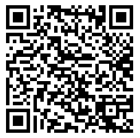
Senior event purchases a la carte
Packages closed on December 31, 2024
A-la-carte is opening Thursday, January 9, 2025, for all items below and will close on the specified date.
Senior T-Shirt (late March) is $25 and closes on Friday, February 28, 2025
Yard Sign (already open now) is $25 and closes on Friday, February 28, 2025
Senior Dinner (Wednesday, April 9, 2025) is $85 and closes on Friday, March 28, 2025
Prom (Saturday, April 26, 2025) is $150 and closes on Thursday, April 24, 2025
Senior Trip (Friday, May 2, 2025) is $200 and closes on Friday, April 25, 2025
Link to purchase a-la-carte: https://fortbendisd.revtrak.net/FBISD-Schools-1082/hs/EHS/ehs-class-of-2025/#/list

Slide 9
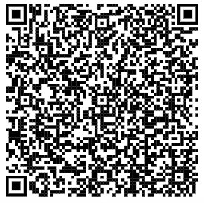
Senior Pictures
CADY will provide a one-stop shop for your Class of 2025 senior portraits. You must be photographed by CADY to be in the yearbook. You may use your purchased portraits for grad announcements, senior yearbook ads, and flawless Insta posts.
Booking is still open at cady.com/schedule.
The last day to schedule your photos with Cady is, March 17, 2025.
The fee to sit for the picture if $10. This is a CADY requirement, not FBISD. If you are in need of a voucher to waive the $10 fee, please email elias.reyes@fortbendisd.gov and we will see if we have any available (no guarantee).

Slide 10
SenioR Pictures Continued
We only have one more road shoot day left for seniors to have their portraits done on campus. Please make sure your student checks with their teacher before making an appointment. We will have times available through 5pm to accommodate students after school. *You must register for your time on the CADY website.
February 13, 2025

Slide 11
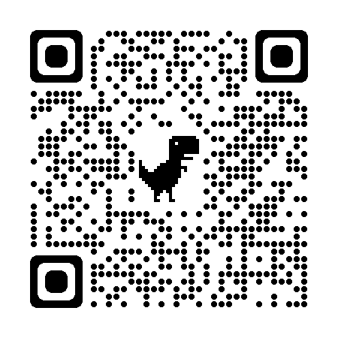
Yearbook
www.yearbookordercenter.com
Job #6946
Yearbooks are still on sale for the 2024-2025 school year.
The book will be release in the summer (2025). Along with personalization options, seniors may also have their book shipped.

Slide 12
Yearbook senior ads Orders due on April 7, 2025

Slide 13
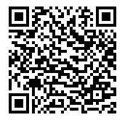
Cap & Gown graduation
Dilly Campus Supply is our Vendor for everything graduation
You may re-use a cap and gown from either Class of 2023 or Class of 2024
If you order online before March 1, 2025, or have placed an order on campus in October 2024 your cap and gown available for pick-up during lunches at Elkins HS on April 1, 2025
If you do not order by March 1, 2025, you will have to go to a Dilly Campus Supply location to pick up your cap and gown.
Link to purchase: https://highschool.herffjones.com/secom/school/TX/Elkins%20High%20School/42006412000/4415/buildpackage/1

Slide 14
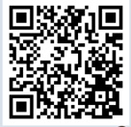
Senior Serve
Date of Event: Saturday, February 8, 2025
We still have tables available for students to purchase – closes Wednesday, January 15, 2025.
Students decorate their own table (ex: theme of Alice in Wonderland), serve food to their guests, provide their own desserts, and put on a skit
Guests will purchase tickets to their own table of choice
Silent Auction Items
All money goes directly to the Class of 2025 for upcoming events (Senior Breakfast, Senior Raffle Prizes, Senior Sunset, Transportation for Walks, etc.)

Slide 15
Pto spring event
Wednesday, March 5, 2025
Field Day!
PTO will send out information about donations and volunteers soon

Slide 16
Senior dinner
When:
Wednesday, April 9, 2025 (only for active Elkins HS Seniors – no guests)
Where:
Safari Texas
*Doors open at 5:30pm and sit down dinner will be served at 6:00pm

Slide 17
Powder puff
When:
Thursday, April 24, 2025 (Juniors vs. Seniors), Kick-Off at 6pm
Where:
Elkins HS Football Stadium
*A sign-up genius will be sent out before Spring Break for those interested in playing (girls) or cheering (boys)

Slide 18
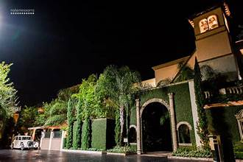
Prom & Venue
When:
April 26, 2025, 8pm to 11pm (no entry after 9:30pm)
Where:
The Bell Tower on 34th
*Guest forms available in early April 2025 & posted in Schoology Group

Slide 19
Senior trip & Venue
When:
May 2, 2025
Arrive to EHS at 4:45am
Arrive to Six Flags around 9-9:30am
Leave Six Flags around 3:00pm
Return to EHS around 8pm
Where:
Six Flags Fiesta Texas
Includes an entry ticket, a meal voucher, and unlimited drinks

Slide 20
Senior sunset
When:
Friday, May 9, 2025
Where:
Elkins HS Stadium
7pm to 9:30pm
What:
PTO Event --- games, fun, music, fireworks, senior prizes raffled off, etc.

Slide 21
Senior AWARDs
When:
May 13, 2025 at 6pm
Where:
Elkins HS Auditorium
Students arrive by 5:15pm
Who:
Any graduating senior who is receiving an honor cord or administrator award – parents will be emailed a few weeks prior notification if their child is being awarded.

Slide 22
Elementary and middle school walks
When:
Thursday, May 22, 2025
Walk between 2nd – 5th periods
Where:
Feeder Elementary Schools, FCMS, FSMS, and QVMS
Signing Up:
Sign-Up Genius Mid-April & First Come, First Served *The Sign-Up Genius will be posted in the Schoology Group

Slide 23
Senior breakfast & graduation rehearsal
When
Thursday, May 22, 2025
Where
Elkins HS Commons (7:30am) & Auditorium for Rehearsal in PM

Slide 24
graduation
When: Saturday, May 31, 2025, at 9am
Where: Fort Bend Epicenter (Rosenberg, TX)
No tickets needed for entry (no limit on number of guests)
Seating first come, first served
Parking spots are first come, first served (must pre-purchase parking)
Parents can enter 1 hour prior (8am)
Graduates' arrival --- we are still waiting on information

Slide 25
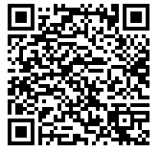
Donations
On the Elkins High School Class of 2025 Revtrak is a donations tab. We are grateful for any donation we receive. Donations help cover the cost of:
Senior Breakfast & Senior Lunch
Transportation to Senior Walks (Elementary and Middle)
Drivers for Senior Walks
Senior Gifts/Prizes/Raffles (Senior Breakfast and Graduation Rehearsal)

Slide 26
Questions?

